Slide 1
AP Statistics 7.3 Reviewing Random Variables

Slide 2
Ex: The rules for means and variances allow you to find the mean and variance of a sum of random variables without first finding the distribution of the sum, which is usually much harder to do.
(a) A single toss of a balanced coin has either 0 or 1 head, each with probability 1/2. What are the mean and standard deviation of the number of heads?
(b) Toss a coin four times. Use the rules for means and variances to find the mean and standard deviation of the total number of heads.
Since each toss is independent, then:
c) If you were to toss the coin 100 times, what is the probability that you will get 60 or more heads?

Slide 3
Ex: An electronic store has determined that its TV sales has the following probability distributions: “X” is the number of the TV units sold
a) Is X discrete or continuous?
b) Calculate the mean, variance, and standard deviation for the probability distribution
c) Suppose that the store has a cost structure determined by the formula: C = 55X+250. Create a probability distribution for cost
d) Find the mean, variance, and standard deviation for the new random variable, C

Slide 4
Part 2) Suppose the company sells another product, “computers”, whose sales follow the distribution: “Y” is the random variable for the number of Computer Units sold
e) Find the mean, variance, and standard deviation for Y
f) Find the following:
g) Suppose profit is given by: Z = 200X+350Y
Find the mean and standard deviation for profit.
h) Suppose TV and Computer sales are independent and normally distributed, find the probability that the electronic store will have make a profit of $300,000?

Slide 5
a) Discrete
b)
c)
d)
Using the formula:
C = 55X+250

Slide 6
e)
f)
g)
This is true only if the sales of the two products are independent of each other.
Using the formula:
Z = 200X+350Y
Combine Rule 1 & 2

Slide 7
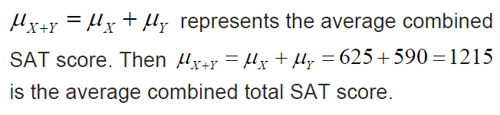
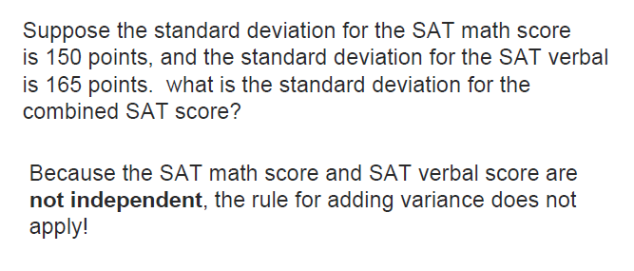
Ex: Suppose the mean and standard deviation for the SAT math (X) and verbal (Y) score is as follow:
a) What is the combined average SAT score?
b) What is the standard deviation for the combined SAT score?

Slide 8
Q1: A computer chip takes 38minutes to manufacture with a std dev. of 4 minutes. If the distribution is normal, then what is the probability that a chip will take over 45minutes to make?
a) 0.040 b) 0.08 c) 0.175 d) 0.227 e) 0.460
Normalcdf ( 45, 1000, 38, 4) =
0.040
Q2: Continuing from prev. question: What is the probability that it will take less than 2 hours to manufacture 3 computer chips? [Assume that the manufacturing time for each chip is independent] a) 0.40 b) 0.807 c) 0.675 d) 0.827 e) 0.960

Slide 9
Q2: Continuing from prev. question: What is the probability that it will take less than 2 hours to manufacture 3 computer chips? [Assume that the manufacturing time for each chip is independent] a) 0.40 b) 0.807 c) 0.675 d) 0.827 e) 0.960
Find the mean and std dev. to manufacture 3 computer chips:
There is a 80.676% chance that it will take less than 2 hours to manufacture 3 computer chips

Slide 10
For a noodle shop, the price of a bowl of noodles on any given day will be randomly picked using a normal distribution with a mean of $1.35 and std dev of $0.10. If a customer buys a bowl of noodles each day for 10 days, what is the probability that he will pay a total of $14.00 or more?
a) 0.316 b) 0.0568 c) 0.3085 d) 0.3160 e) 0.9432

Slide 11
Suppose “Z” is equal to the difference of the two random variables “x” and “y”. Which of the following is equal to the standard deviation of “Z”?

Slide 12
a) Define the random variable “x” and explain what it represent?
b) What is the expected value and what does it represent?
c) For a house valued at $215,000, how much are we expecting to gain or lose each year?
d) What percentage of a property should we set our premiums to break even? How much would it be for a property valued at $215,000?
e) If we want a profit of 1%, how much should we price our premiums?

Slide 13
a) The random variable “x” is the percentage of loss in an insurance policy. The percentage is a percentage of the value of the property insured.
b) The expected value is 0.00825, that means on average, most insurance policies will cost the company about 0.825% of the value of the properties insured.
c) If we are insuring a house that cost $215,000, we would expect it to cost the company about $1773.75
d) If the company plans to break even fiscally, they should charge a premium that is equivalent to 0.825% of the property value. So for a house that is worth $215,000, the premium would need to be about $1773.75 to break even
e) If the company wants to make a profit of 1% of the property values, then they should charge insurance premiums of 1.825% of property values. So a house that is worth $215,000 will have insurance premiums of $3923.75

Slide 14
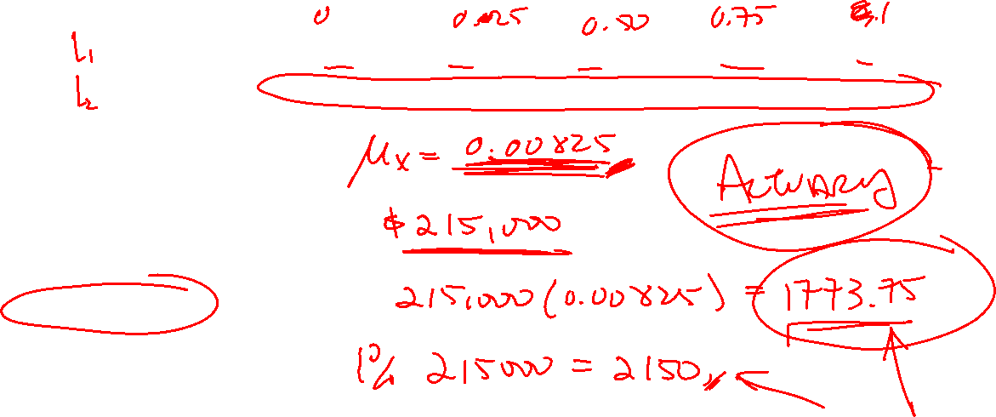

Slide 15
Suppose you have a bias coin where P(head)=0.4. In the first game, you win if the number of heads is between 35% to 45%. In the 2nd game you win if you get heads 55% of the time. For each game, you have a choice of flipping either 40 times or 400 times. How many times should you flip for each game?

Slide 16
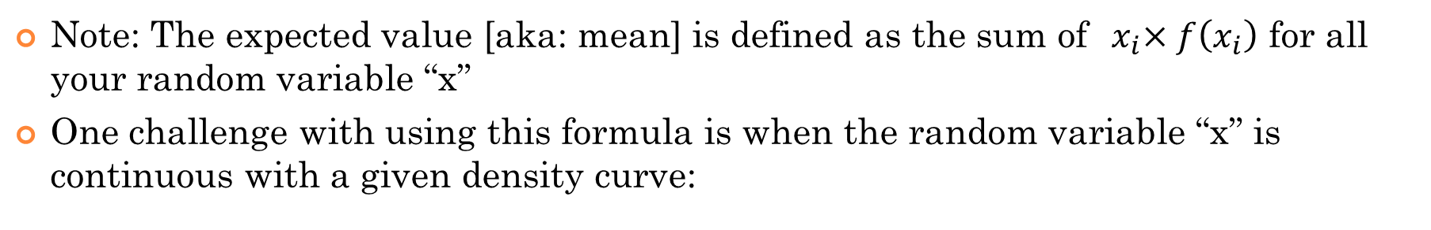
Expected Value for Continuous Random Variables:
Note: The expected value [aka: mean] is defined as the sum of${ x}_{i}×f\left(x_{i}\right)$ for all your random variable “x”
One challenge with using this formula is when the random variable “x” is continuous with a given density curve:
The function of P(x) is usually given:
Probability Distribution P(x)
Note: the area of the density curve must be 100%
Random Variable “X”
The expected value will be the sum of every random variable “x” multiplied by it’s probability function:
To find this value, you will need some basic calculus:

Slide 17
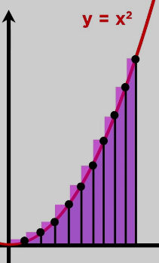
Note: you don’t need this for AP statistics…. Maybe for something later if you plan to pursue statistics in the future…
Crash course on basic integration: - integration is for finding the area of a given function
If we taking the integration of a parabola from 0 to 4, the integration will be the area under this curve from 0 to 4
Back to our question:

Slide 18
So what does this mean??
The expected value of the continuous random variable “x” is 2.13333
NOTE: the expected value does NOT necessarily cut the density curve in HALF!! It’s only when the curve is symmetrical!
Probability Distribution P(x)
Instead, the expected value is the center of mass OR balance point of the distribution!
Random Variable “X”

Slide 19
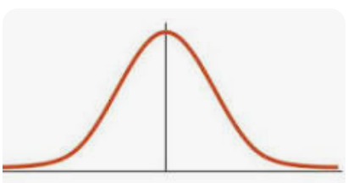
For each of the following density curves, find the expected value:

Slide 20
Q: How do you find the standard deviation of a continuous random variable “X”?
To find standard deviation, first find the variance. Then square root to get the standard deviation:
To get the variance of a continuous random variable “x” we would need to get the integration:
If you are good with calculus, use integration by parts….. If your calculus sucks…. Then just expand and integrate the polynomial……

Slide 21
One Main Idea from Ch7
Suppose you take a sample of 10 units, each with a mean of “x” and std dev. of . What is the mean and standard deviation of the sample?
Ie: Suppose the mean weight of a single egg is 60g with a std dev. of 9g, what is the mean of std dev. of a sample of 10eggs?
Give each egg’s weight a random variable “x₁”, “x₂”, “x₃”, “x₄”,… “x₁₀”
Let the mean and std deviation of each egg be: μ₁, μ₂, μ₃,… μ₁₀ and ₁,  ₂,  ₃,……  ₁₀
The mean and variance of the sample of 10 eggs will be: μ_{sample =} μ₁ + μ₂ + μ₃ + ….+ μ₁₀ and ²_{sample} = ²₁+² ₂+² ₃+……+ ² ₁₀
Note: all the eggs should have the same mean and std dev.:
The mean and variance of the sample of 10 eggs will be: μ_{sample =} 10(μ) and ²_{sample} =10(²)

Slide 22
NOW, suppose you have a sample with a mean and standard deviation, how do you go backwards to find the mean weight and std of a single egg?
Mean Average of the sample
In Ch9, you will learn that the mean of a sample is noted:
The standard deviation of a sample is noted “s”:

Slide 23
Suppose that the average person has a mean of 9 friends with a std dev. of 2.5. An opinion poll ask a SRS of 1100 adults how many close friends they have. What is the probability that the average of the sample (sample mean) is between 8 and 10? The distribution of the sample mean is normal (ch9)
Population:
Sample:
There’s a 100% chance that the average number of friends from a SRS of 1100 adults will between 8 to 10 close friends.

Slide 24
Proof for Rule #1: Suppose X and Y are both random variables given by the formula:
Average of all the Y variables:
Average of all the X variables:
Suppose that there are “n” values in both series:
Take the average of both sides
Simplify
Return to Previous Screen

